Slide 1
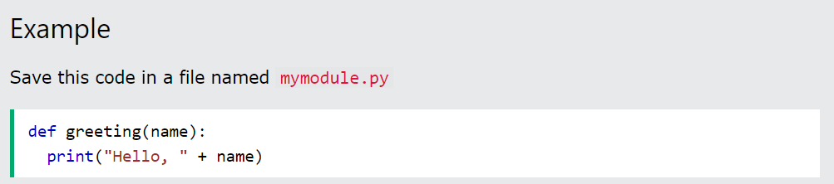
What is a Module?
Consider a module to be the same as a code library.
A file containing a set of functions you want to include in your application.
Create a Module
To create a module just save the code you want in a file with the file extension .py:

Slide 2
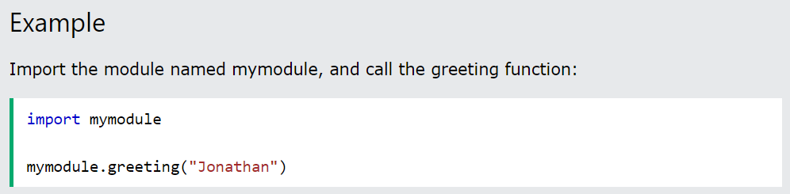
Use a Module
Now we can use the module we just created, by using the import statement:
Note: When using a function from a module, use the syntax: module_name.function_name.

Slide 3
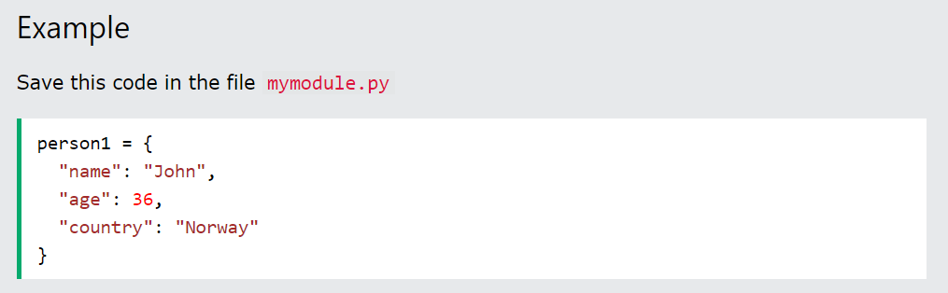
Variables in Module
The module can contain functions, as already described, but also variables of all types (arrays, dictionaries, objects etc):

Slide 4
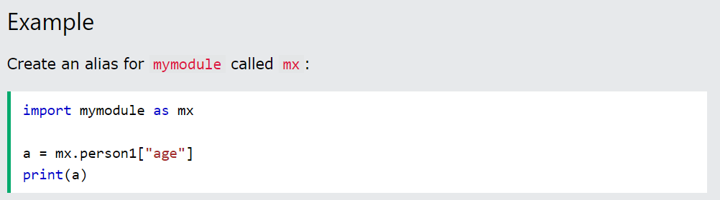
Naming a Module
You can name the module file whatever you like, but it must have the file extension .py
Re-naming a Module
You can create an alias when you import a module, by using the as keyword:

Slide 5
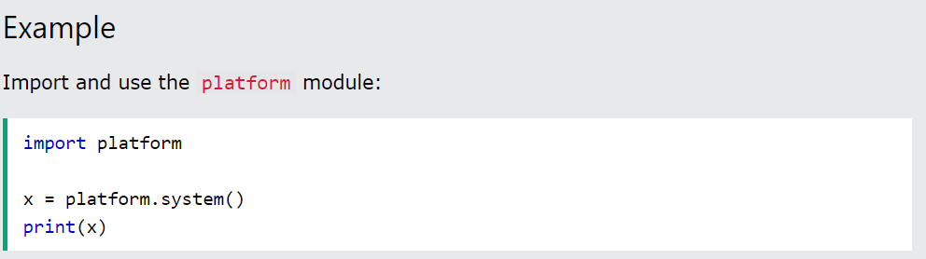
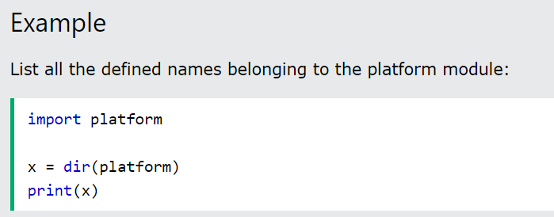
Built-in Modules
There are several built-in modules in Python, which you can import whenever you like.
Using the dir() Function
There is a built-in function to list all the function names (or variable names) in a module. The dir() function:

Slide 6
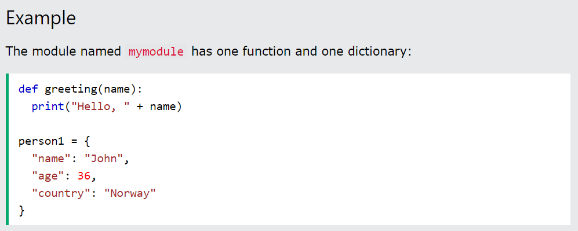
Import From Module
You can choose to import only parts from a module, by using the from keyword.

Slide 7
Python PIP
What is PIP?
PIP is a package manager for Python packages, or modules if you like.
Note: If you have Python version 3.4 or later, PIP is included by default.
What is a Package?
A package contains all the files you need for a module.
Modules are Python code libraries you can include in your project.

Slide 8
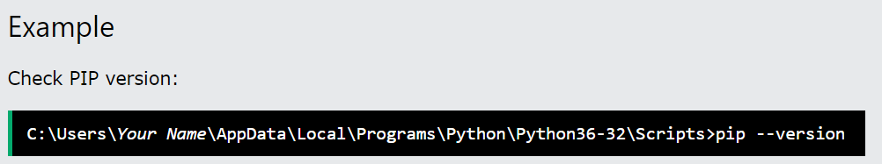
Check if PIP is Installed
Navigate your command line to the location of Python's script directory, and type the following:

Slide 9
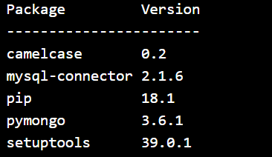
List Packages
Use the list command to list all the packages installed on your system:
Example
List installed packages:
Result :

Slide 10
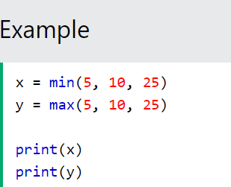
Python Math
Python has a set of built-in math functions, including an extensive math module, that allows you to perform mathematical tasks on numbers.
Built-in Math Functions
The min() and max() functions can be used to find the lowest or highest value in an iterable:

Slide 11

A RegEx, or Regular Expression, is a sequence of characters that forms a search pattern.
RegEx can be used to check if a string contains the specified search pattern.
RegEx Module
Python has a built-in package called re, which can be used to work with Regular Expressions.
Import the re module

Slide 12
Some Python Packages that you should Know
Full Stack Development
Flask: A lightweight web framework that helps in quickly building web applications with simple and minimalistic coding.
Django: A high-level web framework that simplifies the development process by offering a complete solution, including authentication, routing, and an ORM.
Jinja2: A templating engine that allows for dynamic generation of HTML content.
2. Artificial Intelligence
scikit-learn: A simple yet powerful machine learning library offering tools for data analysis and easy-to-use algorithms.
Keras: A high-level neural networks API, simple and user-friendly for building deep learning models.
XGBoost: A popular and beginner-friendly gradient boosting library for classification and regression tasks.

Slide 13
3. GenAI (Generative AI) Hugging Face Transformers: A comprehensive library providing pre-trained models like GPT-2 and BERT for text generation and NLP tasks. DALL·E via OpenAI API: An API for generating images from text prompts, suitable for beginners exploring Generative AI. Langchain – Used to access LLMs 4. Data Engineering Pandas: A powerful data manipulation and analysis library that simplifies handling large datasets. SQLAlchemy: An SQL toolkit and Object-Relational Mapping (ORM) library that makes it easy to interact with databases. Airflow: A workflow management tool that helps schedule, automate, and monitor data workflows efficiently.

Slide 14
Anaconda
Anaconda is the python manager, used to maintain separate python environments in order to isolate them from one another

